Slide 1



EOY 1- 4
Advanced Reporting and Certification
EOY 1-4 Overview
2024-25 Changes
Common Problems
Wrap-Up
Notes:
Welcome to the EOY Advanced training for experienced CALPADS users.
{Introduce self, trainers}
This session is set to last about one and half hours. Although there is a lot of information in the session, we invite any questions you have in the chat box. If you’d like to share your acquired wisdom in answering any questions, feel free to do that in the chat box as well.
In this training, we will provide a brief overview of the EOY submissions and go over the EOY changes for this year.

Slide 2
CALPADS Training Road Map
Introduction
System Overview
Basics
Submission: Data Population
File Type: Data Population
Data Collections
Fall 1-2 Reporting and Certification
EOY 1-4 Reporting and Certification
Skill Building
Skill Building
Data Privacy
Data Population
CALPADS Basics
CALPADS Basics (SELPA)
4 Year Cohort
Notes:
The CSIS training model is designed to be segmented to provide organization of specific topics and concise delivery. We aim to provide focused trainings with relevant information and instruction.
- This slide reflects the CALPADS course catalog. In the top we have the various Subject Areas and their respective Programs shown below each one. The first three skill areas contain programs that are the prerequisite for the Data Collection programs and the EOY Advanced which is part of the EOY 1-4 Reporting and Certification program, that you are attending today. We also have the Skill Building program consisting of courses which are available in self-paced format.

Slide 3


Target Audience
Experienced CALPADS
Users
New to CALPADS?
Attend EOY R&C Trainings
Notes:
We expect experienced CALPADS data Coordinators to be attending this session.
If you are new to CALPADS, we strongly recommend that you attend the regular EOY Reporting & Certification trainings as this session's main focus is on the changes only and we would not be discussing the data requirements and population in this course.

Slide 4




Objective
Identify
Prepare
Coordinate
Certify
the changes for EOY 1-4 submissions
for system changes and local readiness & establish submission strategy
with other staff to ensure everyone is aware of new changes and certification process
EOY 1-4 on time or before the final submission deadline
Project Management
Manage & Maintain Data
Data Literacy
Coalition Building
Notes:
On this slide are the objectives for the session. By the end of this session, participants will be able to:
Identify the the changes for this year and important dates and milestones of the EOY submissions
Learn about the system changes and establish a submission strategy that works best for your LEA
Coordinate with other staff to ensure everyone is aware of new changes
Lastly, certify EOY 1- 4 reports on or before the final submission deadline
In support of the CSIS mission of increasing local capacity among our LEAs, our trainings have a focus on skill development, and so throughout this training we will provide information and guidance to help you develop some of the skills shown on this slide.

Slide 5






Agenda
EOY 1-4 Overview
2024-25 Changes
Certification Review
Common Problems
Wrap-Up
Notes:
Here is the agenda for this training. We will discuss the following:
An overview of the submission
Discuss the details of this year’s EOY changes
Review the certification process
Cover some common problems
Lastly, we will conclude this session with a wrap up recounting key points

Slide 6

Key Dates
Reporting Period
7/1/2024 - 6/30/2025
Zero DD & Certification Fatal Errors
7/11/2025
EOY Certification Deadline
7/25/2025
Amendment Window Deadline
8/8/2025
NOTE: CALPADS Calendar
http://www.cde.ca.gov/ds/sp/cl/rptcalendar.asp
Notes:
Our goal is to help LEAs build their local capacity. Therefore:
The expectation is for each LEA to resolve all fatal errors by July 11th and Approve by end of July.
The EOY snapshot reports will generate on — May 6th
The milestone for zero certification and DD fatal errors — July 11th
The EOY submission window deadline is — July 25th
The FINAL amendment deadline is August 8th , which is one week earlier than the prior year, to accommodate the earlier deadline for the posting of the California School Dashboard. Please note that this is the final deadline for EOY 3 and EOY 4.
The Graduation Cohort cut-off date will remain August 15, the same as prior years in order that students graduating in the summer may be included in the 2024-25 4-year Adjusted Cohort Graduation Rate (ACGR).
This means, the End-of-Year certification deadline and the pull of data for the ACGR have been “de-coupled.”
As a result, there may be a slight difference between the certified count of graduate and completers and those included in the 4-year ACGR
Also, these dates can change so it is best to check the CDE’s calendar using the link on this slide.

Slide 7

EOY Preparation
CALPADS Activities
Stakeholders
Local Systems Activities
HR & staff data
Audit Data
Review changes
CALPADS accounts
EOY calendar
Clear errors by July 11, 2025!
Validations
Error correction strategy
Student Profile
NOTE: EOY Checklist - https://documentation.calpads.org/Training/doc/2023-24EOYChecklistwithCertificationReportSummary.xlsx
Notes:
CALPADS Activities:
Audit your CALPADS accounts and roles
Determine data stakeholders you need to collaborate with
Review upcoming EOY changes internally
Build a EOY calendar using EOY Task List
Update student enrollment and information now
Establish an error correction strategy with SPED Coordinator
Plan for clearing all EOY DD and certification fatal errors by July 11^{th.}
Local SIS Activities
Verify Human Resource department has updated staff demographics data
Audit SIS records to ensure required data are populated
Run validations locally in SIS before uploading files to CALPADS

Slide 8

EOY 1- 4 Highlights
Course Completion
CTE Participants and Completers
Work Based Learning
Program Participants
Student Incident, Restraints & Seclusion
Student Absenteeism
Cumulative Enrollment
Homeless Counts
Reclassified Fluent English Proficient (RFEPs)
Graduate and Completer Counts
Special Education
SWD Postsecondary Status
Notes:
Let’s now start with the highlights of the EOY Submissions.

Slide 9
EOY Data Collections
EOY 3
July 1–June 30
Student Behavioral Incidents
Course completion
EOY 1
July 1–June 30
Grades 7-12
EOY 2
July 1–June 30
Program​
Eligibility/Participation​
​
Title I Part A Basic Targeted ​
​
Title I Part A Neglected ​
​
Armed Forces Family Member ​
​
504 Accommodation Plan ​
​
Opportunity Program ​
​
California Partnership Academy ​
​
Pregnant or Parenting Programs​
CTE participants, concentrators and completers (Perkins Report)
Student Absence Summary
EOY 4
July 1–June 30
SWD Status
SWD Services
PSTS for SPED
Homeless Program
Carnegie Units
College Credit
Work-Based Learning
Cumulative Enrollment
RFEP
One-Year Grads and Completers
Leadership/Military Science
SWD Plans
SWD Meetings
Notes:
On this slide are the four CALPADS EOY Data Collections, with a high-level view of the key data elements submitted in each.
Unlike Fall 1 and Fall 2, EOY reports on the entire academic year - from 7/1 of the prior calendar year to 6/30 of the current calendar year, which means any new students or students who have left during this timeline will be reported.
EOY 1 contains course completion information, including Carnegie units and college credits earned, as well as leadership and military science course completions. EOY 1 also contains CTE participant and completer information, and the Work Based Learning (WBLR) file.
EOY 2 contains program participation information that is submitted in Student Program (SPRG) files.
EOY 3 Contains information on cumulative enrollment, student behavioral incidents, the student absence summary, graduates and completes, homeless youth, and students who take the Summative ELPAC and test as RFEP. EOY 3 contains the Student Incident, Student Incident Results, Student Offense, and Student Absence Summary file types.
EOY 4 contains information on students with disabilities, including plans, statuses (specifically nonparticipation statuses) and postsecondary outcomes for prior year completers. These are reported in SWDS, MEET, PLAN, SERV and PSTS files.
Please note that Student Enrollment (SENR) and Student Information (SINF) must be up-to-date in CALPADS before uploading EOY files.

Slide 10

EOY 1
Course Completion, Career Technical Education, Work-based Learning preparation
Notes:
Let’s now jump into our primer for each EOY data collection, beginning with EOY 1.
Here, we will discuss changes and helpful reminders as you prepare for the EOY 1 data submission.

Slide 11
EOY 1 Data Collection
Data Submitted
Student Enrollment (SENR)
Files Submitted
Course Completion (CRSC)
Student Crs. Completion (SCSC)
Student CTE (SCTE)
Work-based Learning (WBLR)
Staff Demographics (SDEM)
Career Technical Education
Work Based learning
Course Completion
Perkins
CCI
CCI
Perkins
CCI
Site Staff
Staff Involved with Submission
Registrars
Program staff
CTE
Site Administrators
Student System Support Staff

Slide 12
EOY 1 Pre-snapshot Submission Activities
Record Type | Activity | Reasoning | Processing Method | Record Operation Keys
SENR | Ongoing | Enrollment records should be updated with student movement | Transaction | School of Attendance SSID Enrollment Start Date
SDEM | Now | Teachers already in master schedule and assigned to courses | Transaction | Reporting LEA SEID
CRSC | Now | Course records for entire AY in master schedule | Replacement | School of Course Delivery Academic Year ID Academic Term Code
SCSC | Submit all completed grading periods* | Students have or nearly completed ¾ quarters, 1 of 2 semesters 2/3 trimesters GRADES are Available Now | Replacement | SSID School of Course Delivery Academic Year ID Academic Term Code Marking Period Code (For SCSC ONLY)
SCTE | Submit after SCSC is complete | CTE completers must have a capstone course in a corresponding pathway reported in the SCSC | Replacement | School of Attendance Academic Year ID
WBLR | Can Submit a test file | Likely that students are still earning WBLR hours | Replacement | School of Attendance Academic Year ID

Slide 13
CCI Course Completion
CCI Measure | Field Number in CALPADS | Starting in 2019–2020
College Credit Courses | 9.07 | CALPADS Field #9.07 (CRS-State Course Code) is used CCI College Credit Courses. Starting in 2019–2020, the following codes are used for Academic College Credit Courses: • 9020: College Credit Course – Visual Arts • 9082: College Credit Course – Dance • 9096: College Credit Course – Theatre • 9120: College Credit Course – English • 9154: College Credit Course – World Language
 |  | The 7000-8999 codes are used for CTE College Credit Courses Course Section Instructional Level Code [Field #9.19] of “23-College and Credit only” and “24 – Dual Credit” must be selected in conjunction with 7000-8999 codes to be counted CALPADS Data Field #10.18 (Student Course Final Grade): A+, A, A-, B+, B, B-, C+, C, C-, P (passing)
Leadership/ Military Science | 9.07 | For the current year, both of the following course codes are available for use to denote the completion of Leadership/ Military science: State Course Code 9373 – Leadership/Military Science (as of July 1, 2019) State Course Code 9374 – Junior Reserve Officers Training Corps (JROTC) (starting July 1, 2021)
• 9200: College Credit Course – History/Social Science
• 9227: College Credit Course – Other
• 9273: College Credit Course – Mathematics
• 9303: College Credit Course – Music
• 9358: College Credit Course – Science
13

Slide 14
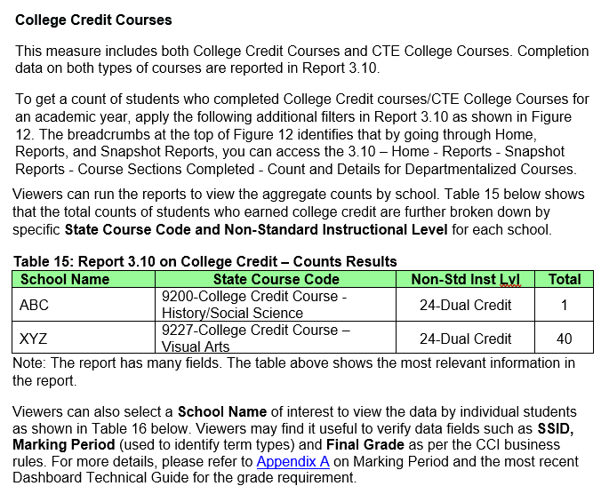
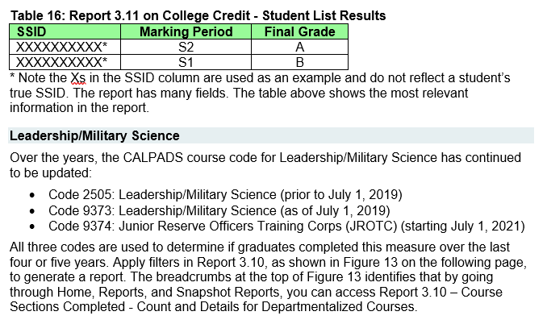
23-24 Handbook:
Connecting CALPADS to the Dashboard
14
Notes:
https://www.cde.ca.gov/ta/ac/cm/documents/caldashhandbook24.docx

Slide 15
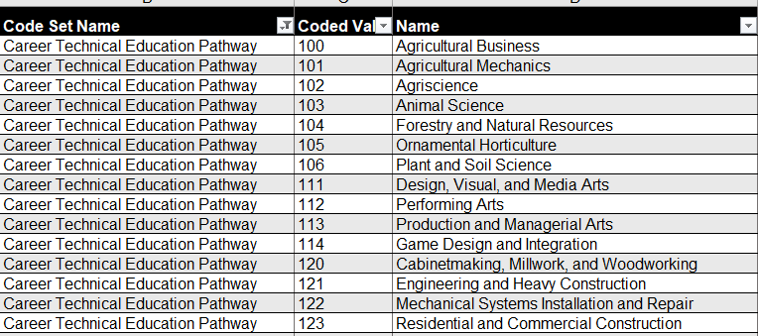
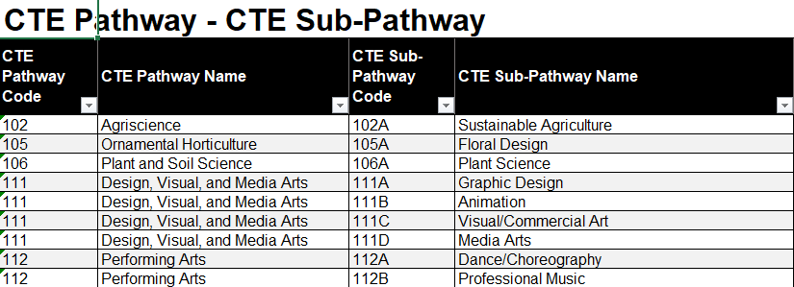
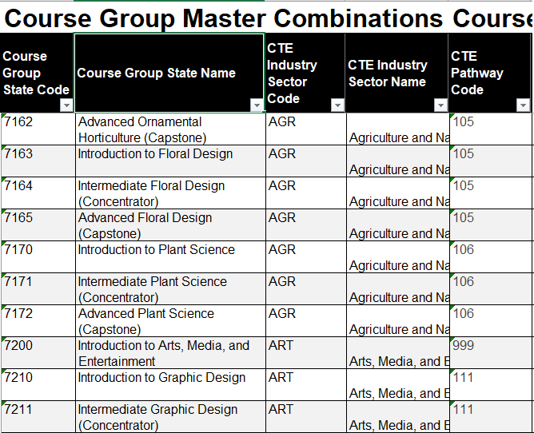
Pain Points
CTE Pathway Mapping
SCTE0698E1 (CERT123)
At least one SCSC record with a Course Section ID at the same Reporting LEA for the student that is mapped to a CRS-State Course Code in a CRSC record that can then be mapped to the CTE Pathway specified for the student in the SCTE file and the SCSC record must have a Capstone Course Indicator = Yes.

Slide 16




Tracking Student WBLR Participation
Categorizing WBL Experiences
Identify opportunities and employers
Document dates, hours, performance
Preserve longitudinal records

Slide 17
Work-Based Learning vs Work Experience
Key Differences
 | Work-Based Learning | Work Experience
Focus | Educational approach, integrating learning with work | Broad term for any paid or unpaid work
Structure | Often structured, aligned with curriculum and industry standards | Can be structured or unstructured
Goal | To connect school experiences with real-life work activities and future careers | To gain practical skills, explore career paths, and develop employability skills
Examples | Internships, apprenticeships, job shadowing, school-based enterprises | Internships, volunteer work, part-time jobs, community service

Slide 18
EOY 1 Reports
Report 3.9
Report 3.10
Report 3.11
Course Sections Completed – Count by Content Area for Departmentalized Courses
Course Sections Completed – Count and Details for Departmentalized Courses
Course Sections Completed – Student List for Departmentalized Courses
Report 3.16
Educational Options Course Completion – Student Count
Report 3.14
Report 3.15
  Career Technical Education Noncompleter Participants - Count
  Career Technical Education Noncompleter Participants– Student List
Legend
Aggregate Report
Supporting Report
Report 3.19
Report 3.20
  Career Technical Education Completers – Count by Pathway
  Career Technical Education Completers– Student List
Report 18.1
Report 18.2
  Work-Based Learning -Count
  Work-Based Learning – Student List
Notes:
EOY 1 Data Mapping Guides in the user manual -- https://documentation.calpads.org/Reports/SnapshotODSReports/#eoy-1-report-mapping-guides

Slide 19
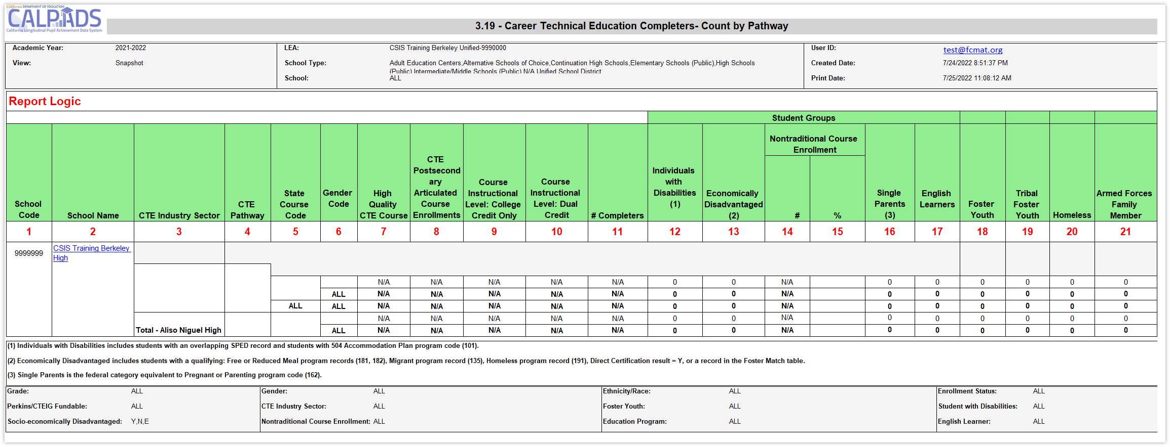
Identify Completers or Misaligned Pathways
Submit SCSC and SCTE files to estimate completer counts prior to EOY

Slide 20

Available
EOY 1 Training
CALPADS User Manual
EOY Road Map
Staff Demographics
Student Course Section
Student Career Technical Education
Work-based Learning
CSIS YouTube Training Channel
End of Year (EOY) Trainings
Other Information
CALPADS Update Flash #229 (WBLR)
SCTE FAQ
CTE FAQ
Course Completion FAQ

Slide 21

EOY 2
Program Participation preparation
Notes:
So, let’s discuss how to get ready for EOY 2 data collection.

Slide 22
EOY 2 Data Collection
Files Submitted
STUDENT PROGRAM (SPRG)
Program
CARS
Student subgroups
Schoolwide programs
Data
Submitted
External Data
SCHOOLWIDE PROGRAM
Site Staff
Program staff
Site Administrators
Student System Support Staff
Staff Involved with Submission

Slide 23
EOY 2 Programs Reported
Code | Program | Type
122 | Title I Part A Basic Targeted | Federal
174 | Title I Part A Neglected | Federal
192 | Armed Forces Family Member | Federal
193 | Tribal Foster youth | Federal
101 | 504 Accommodation Plan | State
108 | Opportunity Program | State
113 | California Partnership Academy | State
162 | Pregnant or Parenting Programs (formerly Cal-SAFE) | State
Notes:
These are the various programs that are reported in the SPRG file type.

Slide 24
EOY 2 Pre-snapshot Submission Activities
Record Type | Activity | Reasoning | Processing Method | Record Operational Keys
SPRG | Ongoing | Program data should be updated as students start and end participation with a particular school. Most records should have been submitted prior to the EOY submission. Certify the schoolwide status in CARS | Transaction | School of Attendance SSID Education Program Code Education Program Membership Start Date Education Service Academic Year Education Service Code

Slide 25
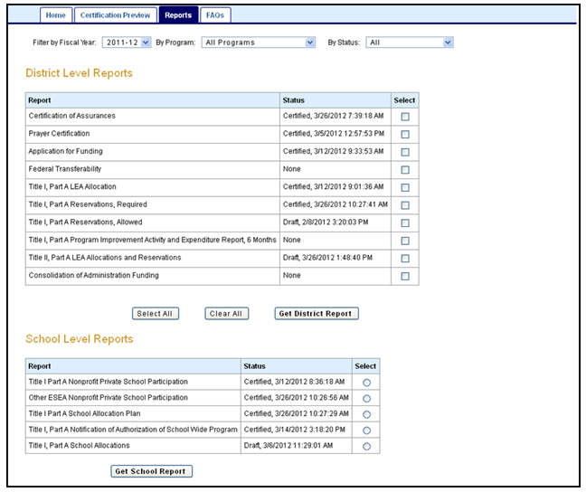
Pain Points
Consolidated Application and Reporting System
A Local Education Agency (LEA) that receives Title I, Part A funds operates one of two programs:
Targeted assistance school (TAS) program,
  Must identify and submit student program records
or
Schoolwide program (SWP)
  Not required to identify individual students or submit records
To be identified in CALPADS, schools operating schoolwide programs must be CERTIFIED in CARS
Notes:
CARS guidance and updates: https://www.cde.ca.gov/fg/aa/co/cars.asp

Slide 26
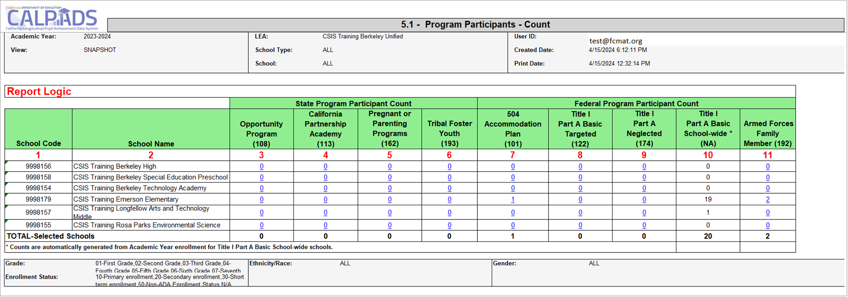
Early Program Counts

Slide 27
EOY 2 Reports Program Participation
Report 5.2
Program Participants - NCLB Title I Part A Basic Targeted Education Services
Legend
Aggregate Report
Supporting Report
Report 5.1
Program Participants - Count
Report 5.3
Program Participants - Count
Notes:
EOY 2 Data Mapping Guides in the user manual -- https://documentation.calpads.org/Reports/SnapshotODSReports/#eoy-1-report-mapping-guides

Slide 28

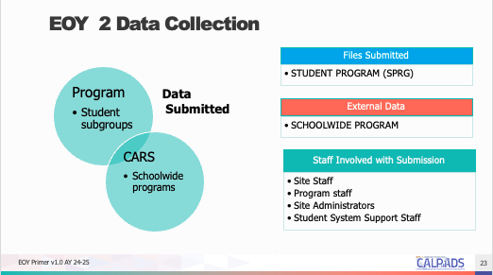
EOY 2 Training
CALPADS User Manual
EOY Road Map
Student Programs
CSIS YouTube Training Channel
Student Program (SPRG) Data Population
End of Year (EOY) Trainings
Other Information
CALPADS Update Flash #228 (TK)
CALPADS Data Guide v11.0
  Section 2.1.3 Student program

Slide 29

EOY 3
Behavioral Incidents, Absenteeism, Cumulative Enrollment preparation
Notes:
Let us discuss what is needed for EOY 3.

Slide 30
EOY 3 Data Collection
Student Incident (SINC)
Data Submitted Via
Student Incident Results (SIRS)
Student Offense (SOFF)
Student Absenteeism (STAS)
Cumulative Enrollment (SENR)
Graduates and Completers (SENR)
RFEP (SELA)
Homeless Program (SPRG)
Incidents
Absence Summary
RFEP
Homeless
Cumulative Enrollment
One Year Grads & Completer
State Indicator
UMIRS
Subgroup data
State indicator
DASS
Suspension Rate
Absenteeism Rate
Subgroup Data
IDEA
Stability Report
Data Submitted
Site Administrators
Staff Involved with Submission
District Administrators
EL Coordinator
Special Ed staff
Attendance Clerks
Attendance Supervisor
NPS School Staff

Slide 31
EOY 3 Pre-snapshot Submission Activities
Record Type | Activity | Reasoning | Processing Method | Record Operational Keys
SENR | Ongoing | Enrollments records are used to determine cumulative enrollments and every student should be exited by the end of the AY | Transaction | School of Attendance SSID Enrollment Start Date
SELA | Ongoing | Reclassified EL students should have their status updated withing an enrollment period | Transaction | Effective Start Date SSID
SPRG | Ongoing | Homeless student data should be verified annually and updated when the student is rehoused | Transaction | School of Attendance SSID Education Program Code Education Program Membership Start Date Education Service Academic Year Education Service Code

Slide 32
More Pre-snapshot Submission Activities
Record Type | Activity | Reasoning | Processing Method | Record Operational Keys
STAS | End of Year | Stas is calculated from attendance. Students may need exit dates to extract the data | Replacement | School of Attendance Academic Year ID SSID
SINC | Now | SINC, SIRS and SOFF must be posted in succession and completely, but there is benefit to submitting them prior to school ending to resolve the majority of errors that may arise. Files submission can be completed by school if schools have different end dates or by incident if Q allows for only new incidents to be extracted | Replacement | School of Attendance Academic Year ID Incident ID Local
SIRS | Now |  | Replacement | School of Attendance Academic Year ID Incident Local ID
SOFF | Now |  | Replacement | School of Attendance Academic Year ID Incident ID Local
EOY Primer v1.0 AY 2023-24

Slide 33

Pain Points
NPS School Incident Reporting
LEAs and NPS schools must have policies and procedures in place to identify, document, and report incidents involving restraint and seclusion for students with disabilities
LEAs have the burden of submission, therefore must facilitate data collection and verify completeness prior to submission
Notes:
NPS School discipline training: https://www.youtube.com/watch?v=82aN0lgEUPU
NPS Student Incident Guide (excel): https://csis.fcmat.org/workflows/Invoke?token=CfDJ8MbNe0Ae_LFBoPfpP1jvtSmxmu7qbjW-c1uSicJPlmqwR-CgJVhel1kaJ5qb6R3_-8lsYLbLC_RN3J-kq4S5ignEEH2yHgmQIURR44Q1euVK7S7chJIj_xrh6Uuox8-OF5oe6D00znyQyDpW8ni5slc4v4PxO0ooCmsf06fnB3Ozez9cqyMBK_wyMFEmoO0hZdkVFPRQ2ICZIsmdt0NrkNZq5738ZaGl6bcrao61hoyE&FilePath=CALPADSResources/NPS-Student-Incident-Guide.xlsx

Slide 34

Restraint And Seclusion
The Special Education Division use certified Restraint and Seclusion data when making its annual monitoring determinations:
LEAs reporting more than 2:1 ratio of restraints or seclusion per pupil will be asked to perform student record reviews
LEAs that :
  Report zero incidents of restraint or seclusion and have greater than 100 students with disabilities; or
  Report zero incidents of restraint or seclusion and have greater than 100 students with disabilities enrolled at Nonpublic Nonsectarian Certified Schools (NPS); or
  Fail to certify the CALPADS EOY 3 submission
  will be flagged for questionable data quality and will have to complete monitoring activities associated with data quality

Slide 35

Homeless Students
CALPADS administrators should coordinate with their local homeless liaisons to identify homeless students
LEAs should submit a Student Program (SPRG) record reflecting an Education Program Code of 191 – Homeless Program
EOY cumulative homeless counts are the basis for federal funding
Update your data in CALPADS as frequently as possible to help county and state liaisons better plan and provide support to districts experiencing significant increases in homeless student enrollment
Notes:
CALPADS Update Flash #295 - California Fires and Homeless Education Program, https://www.cde.ca.gov/ds/sp/cl/calpadsupdflash295.asp

Slide 36
Long Term English Learners (LTEL)
Report | LTEL Grade level | LTEL Definition
Dashboard | Transitional Kindergarten (TK) through grade twelve | An EL student who has not attained English language proficiency within seven years of initial classification
DataQuest | Grades six through twelve) | An EL student who meets all of the following: Enrolled on Census Day (the first Wednesday in October) in grade six through twelve, inclusive; and Enrolled in a US school for six or more years; and Remained at the same English language proficiency level for two or more consecutive prior years, or has regressed to a lower English language proficiency level, as determined by the ELPAC; and For students enrolled in grades six through nine, inclusive: Scored "Standard Not Met" on the previous year’s administration on the English Language Arts (ELA) CAASPP

Slide 37

RFEP Students
It is recommended that LEAs Update RFEP Status in CALPADS by May 15, 2025
24-25 Summative ELPAC or Summative Alternate ELPAC Ends May 31, 2025
  Students will no longer be able to use 2023–24 results for reclassification after May 31, 2025
    For students who may be reclassified based on their 2023–24 Summative ELPAC or Summative Alternate ELPAC scores we recommend testing them no later than May 15, 2025 this will ensure that all eligible students are tested as required by law
  Ensure students transferring have updated records in CALPADS within 10 days
Notes:
CALPADS Update Flash #277 - Reclassifying and Reporting Reclassified Fluent English Proficient (RFEP) Students During the Summer When Students are not Enrolled, https://www.cde.ca.gov/ds/sp/cl/calpadsupdflash277.asp.

Slide 38
EOY 3 Reports
Report 1.21
Report 8.1 (EOY 3)
Cumulative Enrollment – Count
Student Profile - List (EOY3)
Report 7.10
Report 7.12
Incident Count
Incident Results - Student List
Report 1.22
Report 1.23
Graduates and Completers Count
Graduates and Completers Student List
Report 7.11
Incident Result – Count
Report 7.13
Report 7.14
Student Offense - Count by Offense
Incident Offense– Student List
Legend
Report 2.16
Report 2.17
ELA Status – ELs Reclassified RFEP (EOY 3)
ELA Status – ELs Reclassified RFEP Student List (EOY 3)
Aggregate Report
Supporting Report
Report 7.15
Incident Results- Persistently Dangerous Offense Expulsions
Report 5.4
Report 5.5
Homeless Students Enrolled - Unduplicated Count by School
Homeless Student List
Report 7.16
Report 7.18
Incident Removals for Students with Disabilities – Count
Incident Removals for Students with Disabilities – Student List
Report 14.1
Report 14.2
Student Absenteeism - Count
Student Absences – Student List
Report 7.17
Unilateral Removals for Students with Disabilities - Count
Notes:
EOY 3 Data Mapping Guides in the user manual -- https://documentation.calpads.org/Reports/SnapshotODSReports/#eoy-1-report-mapping-guides

Slide 39
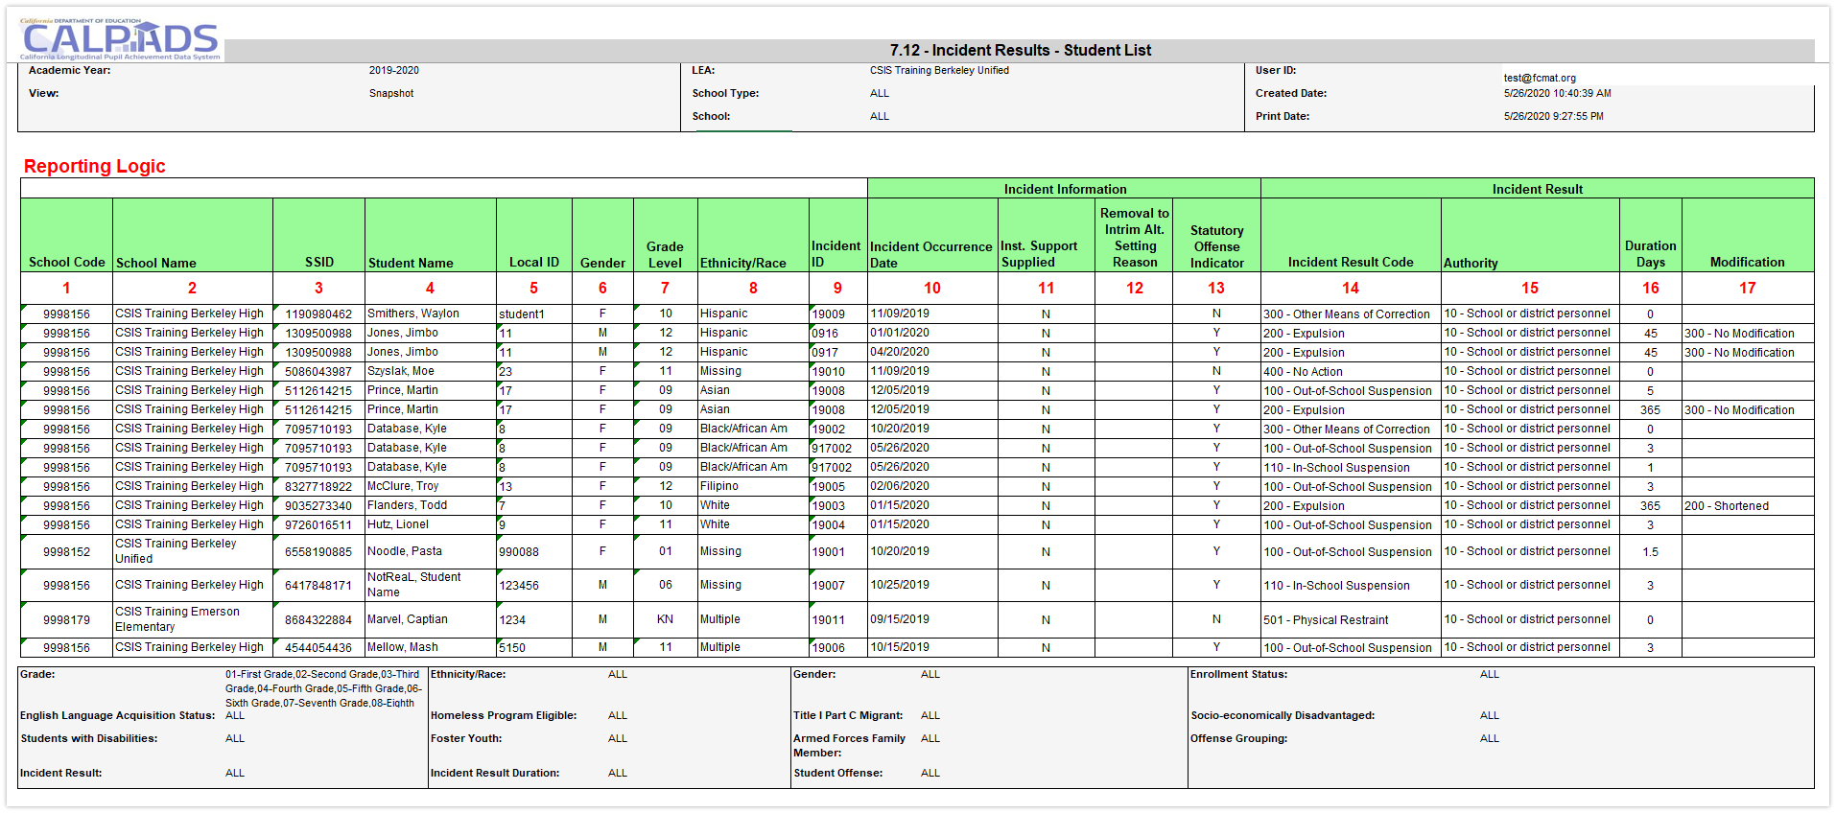
Identify which Report Provides Pertinent Information
Report 7.12 can be used to count individual suspensions and expulsions as well as other results
Notes:
https://www.cde.ca.gov/nr/el/le/yr21ltr0819.asp
https://www.cde.ca.gov/nr/el/le/yr23ltr0221.asp

Slide 40

Available EOY 3 Training
CALPADS User Manual
Student Absence Summary
Incident
Reclassified EL
Student Program
Student Enrollment
Other Information
Relevant FAQ
CALPADS Update Flash #295 (Homeless)
CALPADS Update Flash #277 (RFEP)
Incident Data Collection from Nonpublic Nonsectarian Certified Schools in the California Longitudinal Pupil Achievement Data System
CSIS YouTube Training Channel
End of Year (EOY) Data Population Trainings
End of Year (EOY) Reporting & Certification Trainings

Slide 41

EOY 4
Special Education Program, Services, Postsecondary preparation
Notes:
Last but not least it is time to identify what is required to prepare for EOY 4.

Slide 42
EOY 4 Data Collection
SWD Status (SWDS)
Data Submitted Via
Post Secondary Status (PSTS)
SWD Meetings (MEET)
SWD Plan (PLAN)
SWD Services (SERV)
Data Submitted
Special Education
Postsecondary status
Nonparticipation
Eligibility/Participation status
SWD Status
Nonparticipation reason
Plans and Program settings
Statutory Meetings
Exit Reason, Completion status
Employment and educational status
Site Staff
Staff Involved with Submission
Special Ed staff
Site Administrators
Student System Support Staff
SELPA Directors
Student Families

Slide 43
EOY 4 Pre-snapshot Submission Activities
Record Type | Activity | Reasoning | Processing Method | Record Operational Keys
SWDS, PLAN, MEET | Ongoing | Special Education data is updated as students are tested, meetings are held, records are amended, or eligibility ends. Students' records must be up to date for CAASPP and ELPAC testing | Transaction/ Effective Date | Reporting LEA (District of Service) SSID Reporting SELPA Special Education Meeting Date Student Special Education Meeting or Amendment Identifier Education Plan Type Education Plan Amendment Date
PSTS | Now | Student surveys can be submitted as they are received. The operational key includes the SSID and status code so new records can be submitted with minimal risk to replacing others | Replacement | Academic Year ID Reporting LEA Education Program Participation Type SSID Postsecondary Status Code

Slide 44
SWD Enrollments
Age | Enrollment Status | Enrollment Start Date | Grade Level | School of Enrollment
Zero to 35 months | 50 – Non- ADA Enrollment | Date of parental consent for Part C initial evaluation | IN - Infant | District-level enrollment
3 to 5 years, public preschool OR private preschool serving preschoolers only (served by district on IEP) | 10 - Primary | Date of child’s third birthday for infants turning 3, otherwise Parent Consent Date | PS - Preschool | Preschool with specific CDS code – Enroll at preschool If no specific preschool CDS Code - District-level enrollment
3 to 5 years, private preschool additionally serving grades TK and higher (served by private school on ISP) | 50 – Non-ADA Enrollment | Date of parental consent | PS - Preschool | School 0000002 – Private School Group
5-21, Kindergarten (inc. TK) through 12 (public) | 10 - Primary | First day of enrollment | K-12 – Kindergarten through 12 | School of enrollment
5-21, Kindergarten (inc. TK) through 12 (private) | 50 – Non- ADA Enrollment | Date of parental consent | K-12 – Kindergarten through 12 | School 0000002 – Private School Group

Slide 45

Fall 2 Is Over, Now What?
  Resolve common/ frequently occurring errors
    SENR0606E4 – Missing PLAN record for enrolled Eligible and Participating Student
    PLAN0390E4-0397E4 – Missing Transition Indicators
    SENR04391 - Adult Age Students with Disabilities in Transition Status is required for this record
Use Monitoring Report 16.21 to monitor timelines
Account for SWD completers
  Graduates (Alternate Pathways)
  Certificate of completion

Slide 46

Pain Points SWD PSTS Survey
LEAs are required to report outcomes for SWD who exited secondary education and did not re-enroll
When must data be reported?
For whom must the data be reported?
How many outcomes can be reported for a student?
Can a student be submitted in Fall 2 and EOY 4?
Is there are hierarchy for multiple outcomes?
Are transition students reported?

Slide 47
EOY 4 Reports Students with disabilities
All Reports will be available to both LEA and SELPA Users
Report 16.14
Students with Disabilities - Plan Student list (EOY4)
Report 16.12
Students with Disabilities - Education Plan by Disability (EOY4)
Report 17.3
Postsecondary Survey Outcome for SWDs - Count
Report 17.4
Postsecondary Survey Outcome for SWDs - Student List
Legend
Aggregate Report
Supporting Report
Report 16.13
Students with Disabilities - Federal Setting Count (EOY4)
Report 16.22
Students with Disabilities - Non- Participating Status Report – Count (EOY4)
Report 16.23
Students with Disabilities - Non- Participating Status Report - Student Details (EOY4)
All Reports will be available to both LEA and SELPA Users

Slide 48
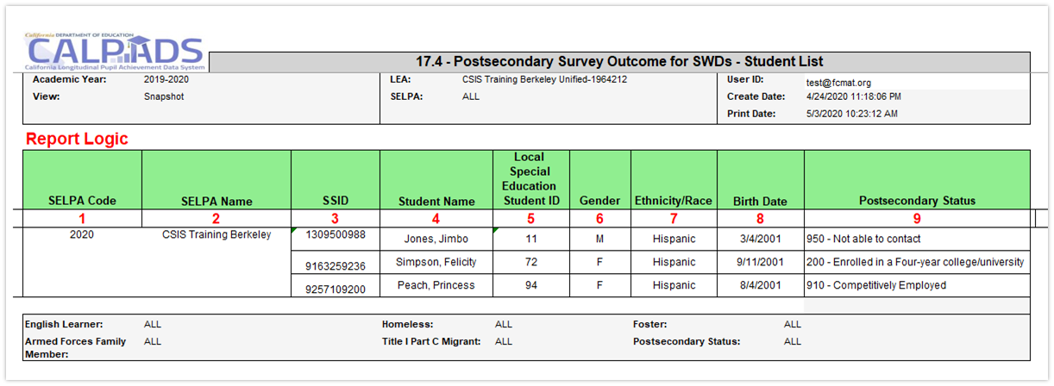
Postsecondary Status Data Analysis
Supporting Report 17.4 will list SWD and their postsecondary outcomes. Detail data is often found in supporting reports, data coordinators should ensure that the proper report is reviewed early in the submission window so there is time to reconcile data

Slide 49

Available EOY 4 Training
CALPADS User Manual
Students with Disabilities Status (SWDS)
Special Education Plan (PLAN)
Special Education Meetings (MEET)
Special Education Services (SERV)
Postsecondary Status
CDE Guidance
Reporting Data for Students with Disabilities
Special Education File Submission Scenarios
Special Education Data FAQs
Appropriate SWDS Status and NonPart Reason for Student Exit Categories and Completion Statuses.xlsx
CSIS YouTube Training Channel
CALPADS Special Education Roadshow 2024
Creating and Maintaining Statewide Student Identifiers for Students with Disabilities in CALPADS

Slide 50

EOY Checklist
EOY Data Uses
EOY Checklist

Slide 51
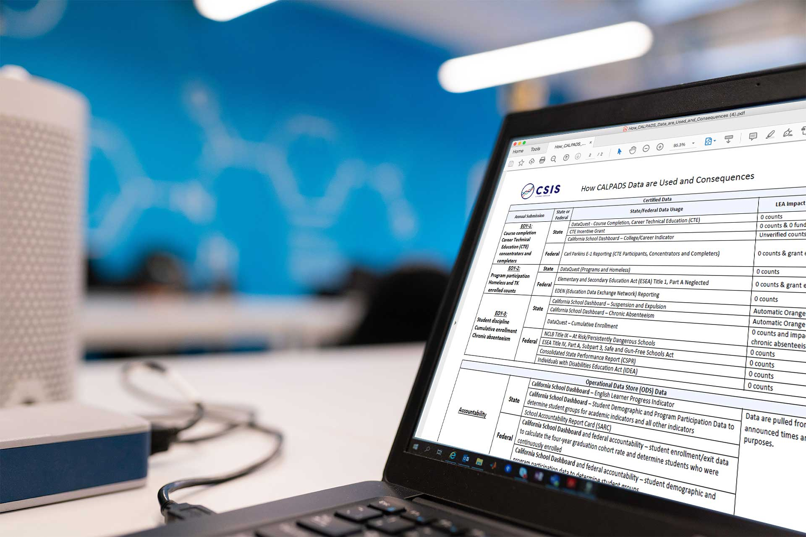
EOY 1 – What are the data used for?
CTE
  Completer counts for Perkins V
  Completer counts for CCI Dashboard
Course Completion
  Counts of students earning college credit for the Dashboard
  Counts of students completing Leadership/Military Science courses for the Dashboard
  Work Based Learning

Slide 52

EOY 1 – Checklist
Ensure CTE Completers have been appropriately identified in your student information system
Ensure all students completing College Credit courses have been reported
Ensure all students completing Leadership/Military Science courses have been reported
Ensure your vendor has translated credits earned into Carnegie Units
Ensure Work Based Learning data submitted

Slide 53
Dashboard CCI Courses
State Course Code | State Course Code Name
9020 | College Credit Course – Visual Arts
9082 | College Credit Course – Dance
9096 | College Credit Course – Theatre
9120 | College Credit Course – English Language Arts
9154 | College Credit Course – World Languages
9200 | College Credit Course – History/Social Science
9227 | College Credit Course – Other
9273 | College Credit Course – Mathematics
9303 | College Credit Course – Music
9358 | College Credit Course – Science
9373 | Leadership/Military Science
7000–8999 | Any CTE course code indicated in Nonstandard Instructional Level as College Credit Only (23) or Dual Credit (24)
Notes:
Data submitted in the CRSC and SCSC files as part of the EOY 1 submission are used to identify whether students in the 4-year Adjusted Cohort Graduate Rate (ACGR) are prepared for college/career as measured by the College/Career Indicator (CCI) on the California School Dashboard.

Slide 54
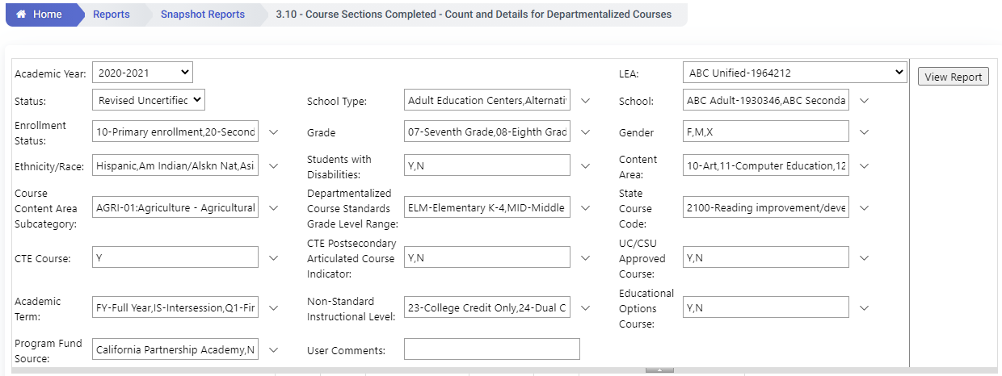
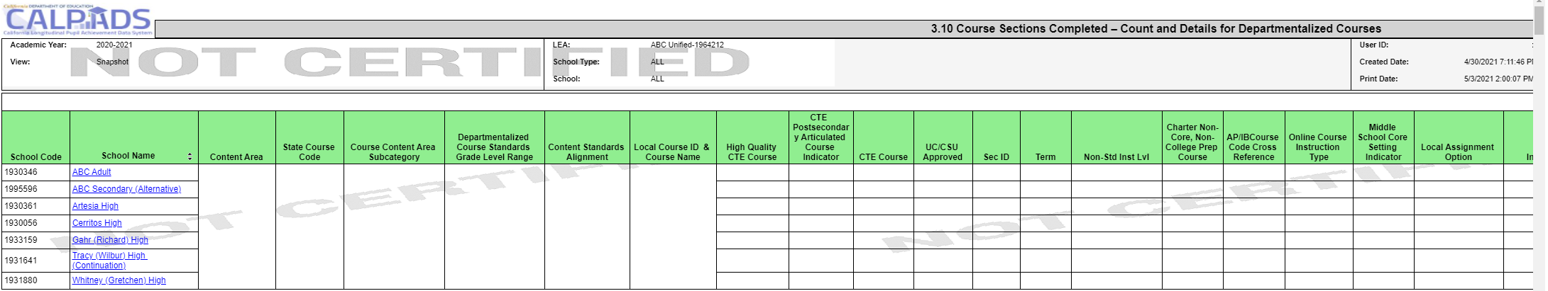
EOY 1 - Reviewing College Credit Courses
Review Report 3.10 - Course Sections Completed - Count and Details for Departmentalized Courses
The report should be requested twice with different filters.
To find college credit courses and Leadership/Military Science in the 9x series select the State Course codes of 9020, 9082, 9096, 9120, 9154, 9200, 9227, 9273, 9303, 9358, 9373
To find the CTE courses with the Non Standard Instructional codes of 23 and 24 select the CTE Course = Y and Non Standard Instructional Level to 23 and 24
Notes:
To find both sets of courses that satisfy the college credit and Leadership/Military Science the report should be request twice with different filters.
To find college credit courses and Leadership/Military Science in the 9x series select the State Course codes of 9020, 9082, 9096, 9120, 9154, 9200, 9227, 9273, 9303, 9358, 9373
To find the CTE courses with the Non Standard Instructional codes of 23 and 24 select the CTE Course = Y and Non Standard Instructional Level to 23 and 24

Slide 55
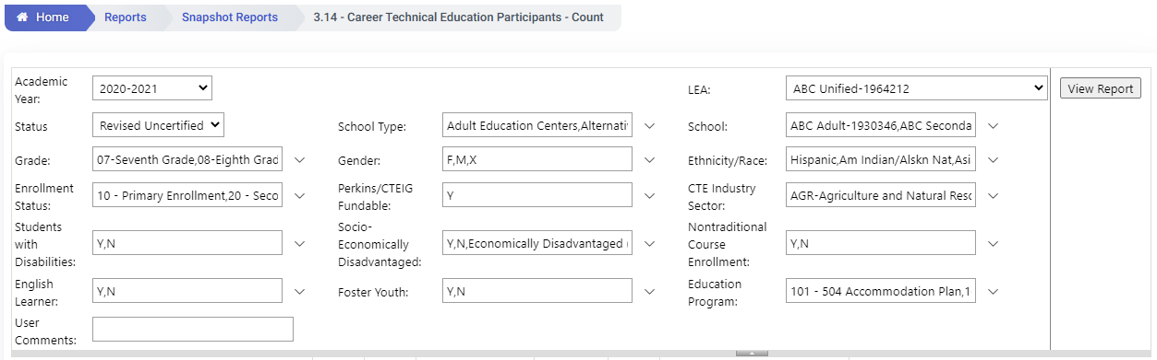
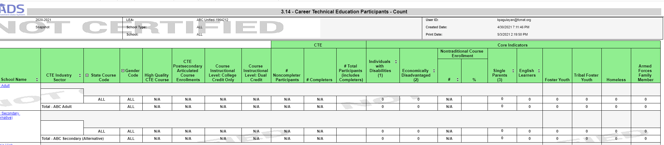
EOY 1 - Reviewing CTE Data
Review Report 3.14 Career Technical Education Noncompleter Participants- Count
Filter on 12th graders to verify students who completed or were participants in 12th grade
Set Perkins/CTEIG Fundable to ALL to capture all students. Otherwise, it will default to courses only flagged a HQ CTE.
Filter for other specific sub-groups that comprise the core indicators (optional)

Slide 56
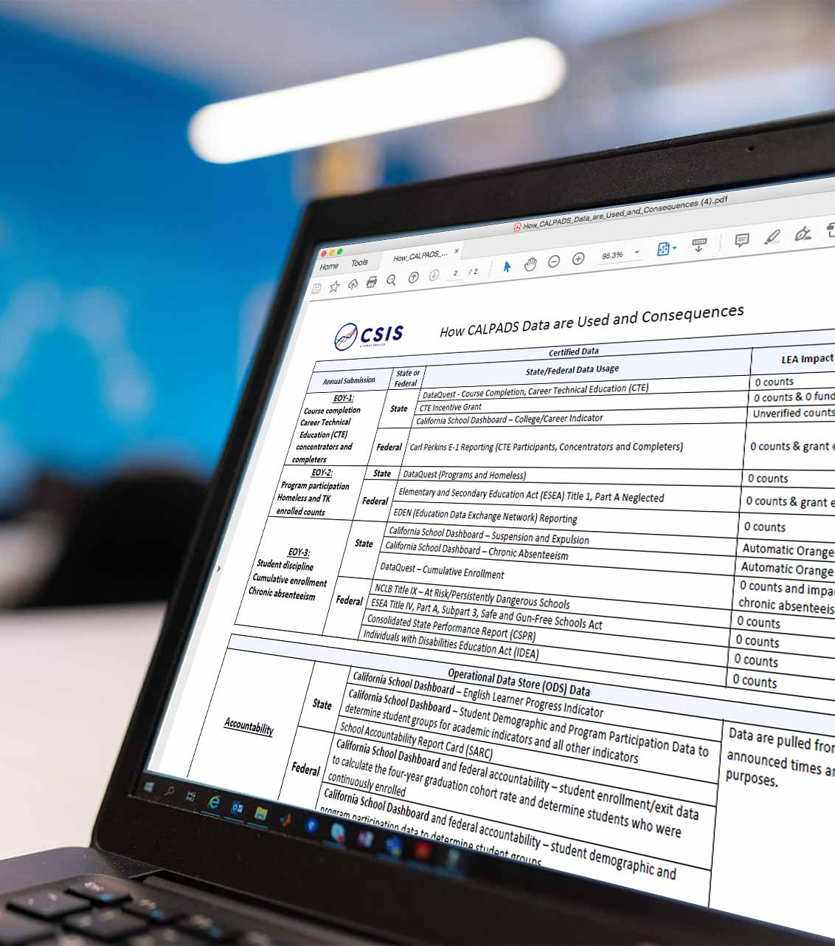
EOY 3 – What are the data used for?
Cumulative Enrollment (SENR)
  Basis for denominators for cohort graduation, suspension and chronic absenteeism rates for Dashboard and DataQuest
  Identification of students groups for accountability and federal reporting
    Socioeconomically disadvantaged, special education, English Learners, Homeless, Foster, Migrant, Military Family
Incident Data (SINC, SOFF, SIRS)
  Suspension rate for Dashboard, ESSA, IDEA and DataQuest
  Restraint and seclusion data for state and federal reporting, and DataQuest
Student Attendance Summary Data (STAS)
  Chronic absenteeism rate for Dashboard and ESSA reporting

Slide 57
EOY 3 – What are the data used for?
RFEP (SELA)
  English Learners reclassified from July 1 to June 30
Homeless Students (SPRG)
  Federal reporting
  Accountability subgroups
Graduates and Completers (SENR)
  One-year Graduate and Completer Counts for federal reporting and public reporting on DataQuest
Notes:
See Flash 191

Slide 58
EOY 3 Checklist – Cumulative Enrollment
Ensure all students with primary enrollments anytime from July 1 – June 30th are reflected in the Cumulative Enrollment Reports
Ensure your cumulative enrollment is GREATER than your Census Day Enrollment
Notes:
Use the Cumulative Enrollment Type filter to view different cumulative counts
Adjusted Enrollment, Cumulative Enrollment and Completer Enrollment
Adjusted Cumulative Enrollment is only those records that have an Enrollment Start Date > = July 1 of the Report Academic Year.
For example: Report Academic Year = 2021-2022
Enrollment Start Date => July 1, 2021 would be Adjusted Cumulative Enrollment
One-year completers = to include in revisions to pull through 8/15 for grad/completers only

Slide 59
EOY 3 Checklist – Incidents
Ensure all incidents resulting from violations of Education Code Sections 48900 and 48915 have been reported for all students (including students attending NPS schools) regardless of the outcome and duration of a removal
Report all instances of restraint or seclusion even if it was not the result of a violation of 48900 or 48915 (including students attending NPS schools)
LEAs required to report incidents that occurred at Nonpublic, Nonsectarian Schools: https://www.youtube.com/watch?v=q8IEYoqlwCE
Double check schools that generate a CERT071 error (No Discipline Data Submitted for a School)
  Accountability can elect to assign an automatic color or Orange or Red for the suspension indicator in the Dashboard for specific schools not submitting ANY Incident data.

Slide 60
EOY 3 Checklist – Incidents
Report all results for each incident for each student
Report any increment of a day for suspensions for all students
Report the duration of all:
  Suspensions (in and out of school)
  Expulsion
Ensure a site is not expelling any students solely for Defiance or Disruption (E.C. 48900 (k))
Ensure the site is not suspending (unless under E.C. 48910) or expelling TK-12 students solely for Defiance or Disruption

Slide 61

EOY 3 - Incident Data Tips
Review report 7.10 – Incident Results – Count
What are your total expulsions? (DQ)
What are your total in and out of school suspensions? (DQ and Dashboard)
What are your total suspensions by subgroup (using filters)? (DQ and Dashboard)
Compare these totals to your Cumulative Enrollment report (1.21)
Did you collect/report restraint/seclusion data for general education students?

Slide 62
Revised Student Absence Summary (STAS) File
Chronic Absenteeism will now be calculated using the following formula:
Non-ADA-Generating Independent Study Days + In-Person Days Absent Excused + In-Person Days Absent Unexcused + Out-of-School Suspension Days
DIVIDED BY
Expected In-Person Attendance Days (includes in-school suspension days) + ADA-Generating Independent Study Days + Non-ADA Generating Independent Study Days
The sum of 13.21 – Non-ADA Generating Independent Study Days and 13.22 – ADA-Generating Independent Study Days will be used to calculate the days a student participated in independent study for purposes of:
  AB 130/AB 167 – Students participating in independent study >= 15 days

Slide 63
EOY 3 Checklist – Chronic Absenteeism
Ensure staff have been appropriately identifying students as present or absent in your local SIS
Ensure ADA-generating and Non-ADA-generating Independent Study Days are accurate (remember this will be used to determine number of days a student participated in independent study)
Follow up with schools with any schools with 100% perfect attendance to ensure data are correct
Make sure adjustments are made to expected attendance days for students that were on maternity or paternity leave to exclude those days from the expected
Ensure any student reported as being absent for out-of-school suspension has a SINC, SIRS, and SOFF record
Ensure students who are exempted from attendance reporting are appropriately identified in the STAS File

Slide 64
EOY 3 Checklist – Homeless and RFEP Students and Graduates and Completers
Use report 2.16/2.17 to verify RFEP student counts
Ensure when RFEP record is submitted, the student has an overlapping enrollment record (Flash#219) - Validation will be in place in May 2024
Verify Homeless counts on report 5.4
Use report 1.22/1.23 to confirm one-year graduate and completer counts
Notes:
This is part of the work to move one-year grad reports from Fall 1 to EOY to be consistent with the pulling of the data for the cohort.
One-year completers are to be included in revisions to pull through 8/15 for grad/completers only

Slide 65
EOY 4 – What are the data used for?
Special Education (SWDS, MEET, PLAN)
    Student counts for IDEA
    Special Education Monitoring
    DSEA – Dashboard accountability
Special Education Services (SERV)
    Special Education Monitoring
Postsecondary Status (PSTS)
    Post-school outcomes for IDEA; outcomes of SWD who exited secondary education in prior AY
Notes:
The SPED data collected for SWD provides information for accountability and is required by legislation.
Special Education (SPED)
Student counts and program exits for IDEA
Special Education Monitoring
DSEA – Dashboard accountability
Special Education Services (SSRV)
Special Education Monitoring
Postsecondary Status (PSTS)
Post-school outcomes for IDEA; outcomes of SWD who exited secondary education in 2019-20

Slide 66
EOY 4 Checklist
Use SEDS searches (custom or vendor-created) to monitor your data
Ensure teachers and case managers have saved or locked IEPs and amendments, even in cases where a meeting took place but parent has not signed the plan
Review any transactions that you have marked as “Do Not Report” in your SEDS
  Is this a reportable transaction? If so, correct the error and submit the transaction to CALPADS
Check with case manager and ensure any students who were exited from Special Education, have all necessary exit information populated in the SEDS
  Exit Date
  Exit Reason
  Eligibility Status
Ensure the SSID and Local ID fields are both populated in the SEDS (file will fail in CALPADS if not populated)

Slide 67
Submit Postsecondary Follow-up Results
Sent to CALPADS by special education data system (SEDS)
Ensure all students with disabilities who have exited secondary education in prior AY have been surveyed for their postsecondary outcomes and responses have been recorded in the special education data system
For students who refused to answer or the LEA was unable to contact – record those results as well
Flash 203 provides a survey template for providing Postsecondary Status information for students with disabilities as part of EOY 4: https://www.cde.ca.gov/ds/sp/cl/calpadsupdflash203.asp
If special education vendor does not allow population of multiple postsecondary status codes, they may be entered via online maintenance

Slide 68

Identify Students Completing Work-Based Learning Programs
Work with case managers to identify SWDs who have completed at least 100 hours of any work-experience program in any grades 9-12 :
  Workability
  Department of Rehabilitation Student Services
Assist your CALPADS Administrator in identifying any courses for SWDs that focus on classroom-based work exploration
Ensure these data are entered into the SIS for work-based learning reporting

Slide 69
How do I verify the DSEA information in CALPADS?
Accountability DSEA Extract
-SWDs reported by other LEAs with the requestor as the DSEA (receiving)
-SWDs reported by the requestor with a different DSEA (sending)
-Limited in grade level and enrollment status.
- Does not include charter schools
Informational DSEA Extract
- SWDs not enrolled in the requestor’s LEA but have their LEA populated as the DSEA
- All grade levels and enrollment statuses
-Includes charter schools
Definition of DSEA: https://documentation.calpads.org/Glossary/CASEMIS/DSEA/
CALPADS User Manual: https://documentation.calpads.org/Extracts/DSEAExtract/#district-of-special-education-accountability-dsea-extract

Slide 70
Review the CALPADS DSEA Accountability Extract
Verify your LEA is correctly SENDING accountability to another LEA
  If not, modify this in the student’s PLAN record
If you are RECEIVING accountability for a student, verify that your district is the DSEA
  If not, contact the Reporting LEA and ask that they correct the record
Verify that your LEA is accountable for all SSIDs in this extract
  If not, contact the Reporting LEA and ask them to modify the DSEA in the PLAN record
Work with your group to find the kids your LEA is accountable for!

Slide 71

CHANGES
Discuss changes for EOY 1-4
Notes:
Let’s now take a closer look at the EOY 1-4 changes for this year.

Slide 72

EOY 1
Changes

Slide 73
2024-25 – EOY -1 Validation Changes
Functionality | Change
EOY-1 Validations | New - Conversion of CVRs to DD/CDDs
 | Modified - WBLR0649E1 (F) – Severity changed from Warning to Fatal If Work-Based Learning Type Code is equal to 10 (Internship), then State Course Code - Embedded Work-Based Learning must be populated with a CTE or Work Experience Course (9500-9502)
 | Disabled – - CERT004, CERT081, CERT098, CERT099, CERT100, CERT123
Notes:
Here we will discuss the validation changes for this year and their impact.

Slide 74
2024-25 – EOY -1 New CDDs
Old Error # | Error # | Severity | Error Name
CERT004 | SENR0716E1 | F | Invalid Student Ethnicity Missing Indicator and Student Hispanic Ethnicity Indicator
CERT004 | SENR0717E1 | F | Missing overlapping SINF record
CERT004 | SENR0661E1 | F | Invalid Student Race Missing Indicator and Student Race Code Combination
CERT081 | SENR0687E1 | W | No Student Course Section Data for a Secondarily or Short Term Enrolled Student
CERT098 | SCSC0681E1 | F | Student Course Section for SSID Not Enrolled during Report Period
CERT099 | SENR0693E1 | W | No Student Course Section Data for a Primarily Enrolled Student (SCSC)
CERT100 | CRSC0686E1 | W | No Enrollment for Course Section (CRSC)
CERT123 | SCTE0698E1 | F | Missing or invalid SCSC record for CTE Completer
Notes:
CERT004 (Ethnicity / Race Data Missing) is split into 3 separate Data Discrepancies (DDs) with corresponding fatal CDDs for EACH EOY submission now.

Slide 75
2024-25 – EOY Reports Changes
Functionality | Change
EOY 1 - Reports | Modified - EOY Report Changes (SN, SELPA, C/A) Report 18.1 - retired "Non-Registered Pre-Apprenticeships" Work-Based Learning Type (Code 30) column removed.
Notes:
Here we will discuss the reports changes for this year and their impact.

Slide 76
EOY 2
Changes
Notes:
We will start with the EOY 2 changes.

Slide 77
2024-25 – EOY Certification Error Changes
Functionality | Change
EOY 2 - Validations | New - Conversion of CVRs to DD/CDDs SPRG0723E2 (F) - Invalid Age for Pregnant or Parenting student - validation on Pregnant or Parenting (162) age not to exceed 19 years of age
 | Modified - CERT073 (W) - to include 192 - Armed Forces program
 | Disabled – - CERT004
Old Error # | Error # | Severity | Error Name | Type
CERT004 | SENR0661E2 | F | Invalid Student Race Missing Indicator and Student Race Code Combination | CDD
CERT004 | SENR0716E2 | F | Invalid Student Ethnicity Missing Indicator and Student Hispanic Ethnicity Indicator | CDD
CERT004 | SENR0717E2 | F | Missing overlapping SINF record | CDD
Notes:
Here we will discuss the validation changes for this year and their impact.
For EOY 2 we will continue converting CERT errors to Data Discrepancies.
CERT073 the programs not submitted error will now include the Armed Forces program (there is no end of year program participation data for this school. See CALPADS Data Guide for a list of programs collected in the End of Year submission).
There are ongoing discussions of whether the pregnant and parenting program should have age validations.
Again, CERT004 (Ethnicity / Race Data Missing) is split into 3 separate Data Discrepancies (DDs) with corresponding fatal CDDs for EACH EOY submission now.

Slide 78
EOY 3
Changes
Notes:
Okay, now its time for the EOY 3 updates.

Slide 79
2024-25 – EOY 3 Validation Changes
Functionality | Change
EOY 3 Validations | New - Conversion of CVRs to DD/CDDs SENR0719 (W) - Student Age should be greater than 0 and less than or equal to 22 if school is not a charter
 | Modified - STAS from NPS schools no longer permitted to be submitted SENR0695E3 - won't trigger on NSP students missing the STAS SENR0651E3 - will trigger if you submit STAS (even exemptions) for NPS student
 | Disabled – - CERT004, CERT067, CERT106, CERT112, CERT113, CERT126, CERT128, CERT129, CERT131, CERT149, CERT150, CERT151, CERT152, CERT153, CERT154, CERT155, CERT156, CERT157, CERT158, CERT162, CERT163, CERT165, CERT166
Notes:
Continuing with the theme of the year we will be converting the majority of CERT errors to Data Discrepancies. And again, the great advantages of the conversion is that Data Discrepancies are available outside the submission window being unrelated to the snapshot. This also allows the DDs to process much more quickly than CERT errors being free of the revision.
SENR0719 (W) background: Replaces the previous deactivated SENR0012 which was the "worst system resource offender". After discussions, it was decided to not reactivate SENR0012 and instead break the validation into two separate validations for each EOY 3 and Fall 1.
So, the homeless program, is under review for an age validation much like the pregnant and parenting program from EOY 2. .
NPS schools will have validations to enforce the restriction of STAS records. SENR0695E3 and SENR0651 will be active this EOY.

Slide 80
2024-25 – EOY 3 – New CDDs - 1
Old Error # | Error # | Severity | Error Name
CERT004 | SENR0661E3 | F | Invalid Student Race Missing Indicator and Student Race Code Combination
CERT004 | SENR0716E3 | F | Invalid Student Ethnicity Missing Indicator and Student Hispanic Ethnicity Indicator
CERT004 | SENR0717E3 | F | Missing overlapping SINF record
CERT067 | SENR0649E3 | F | ELAS Student Not Reported
CERT106 | SENR0657E3 | W | Invalid “TBD” English Language Acquisition Status Code
CERT112 | SENR0317E3 | F | Student Enrollment Record in Previous AY Not Exited
CERT113 | SENR0656E3 | F | Missing Student Initial U.S. School Enrollment Date K–12
CERT126 | STAS0706E3 | F | Missing Primary or Short-term Enrollment Record for a student with Absence Summary Data
CERT128 | SENR0695E3 | F | Missing Absence Summary Data for Student
CERT129 | STAS0707E3 | F | Expected Attendance Days is greater than Total Enrollment Days
CERT131 | SENR0715E3 | F | Student Enrollment Record in Active Reporting AY Not Yet Exited
CERT149 | SENR0712E3 | W | Missing Expulsion or Suspension Incident Result Record
CERT150 | SENR0697E3 | W | Missing Expulsion Incident Result Record
CERT151 | SOFF0709E3 | W | Invalid Student Offense and Incident Result Code Combination
CERT152 | SOFF0710E3 | W | Invalid Incident Result Code and Grade Level Combination for Student Offense Code 511 (disruption, defiance)
Notes:
Here is a list of the new Data discrepancies that are replacing the CERT errors for EOY-3.

Slide 81
2024-25 – EOY 3 – New CDDs - 2
Error # | Old Error # | Severity | Error Name
CERT153 | SINC0699E3 | F | Missing Student Incident Result (SIRS) Record for Student
CERT154 | SOFF0711E3 | F | Missing Student Incident (SINC) Record for Student
CERT155 | SINC0700E3 | F | Missing Student Offense (SOFF) Record for Student
CERT156 | STAS0708E3 | F | Missing Suspension Data for a student who was reported as absent due to either out-of-school suspension or in-school suspension
CERT157 | SINC0701E3 | F | Invalid Incident Result Code and Removal to Alternative Setting Reason Code combination
CERT158 | SINC0702E3 | F | Missing Removal to Interim Alternative Setting Reason Code
CERT162 | SIRS0704E3 | F | Missing Student Offense (SOFF) Record for student with an Incident Result for a reportable offense
CERT163 | SIRS0705E3 | F | Missing Student Instructional Support Indicator
CERT165 | SENR0526E3 | F | Invalid "EL" English Language Acquisition Status Code
CERT166 | SENR0660E3 | F | Invalid "TBD" English Language Acquisition Status Code
Notes:
These are additional newly converted CDDs for EOY-3.

Slide 82
2024-25 – EOY 3 Reports Changes
Functionality | Change
EOY 3 Reports | Modified - SN Report 14.2 - Chronically Absent (Accountability) column business rules will include TK students

Slide 83
2024-25 – EOY 3 Extract Changes
Functionality | Change
EOY 3 – Extracts | New – C/A Report 1.22 –added to Supporting Report Extracts Modified – Cumulative Enrollment (CENR) extract have the following five new fields: English Language Acquisition Status Start Date Provisional Long-Term English Learner Start Date Initial US School Enrollment Date K-12 Earliest SENR Enrollment Start Date Earliest EL Status Start Date - Start Date and RFEP Date
Notes:
Here are the extract changes as a result of the changes for EOY 3.
The Cumulative Enrollment Extract (CENR) will have LTEL information for users to view calculated LTEL start date and the data points that make up the calculations in CALPADS. The extract will include the five additional fields as listed on this slide.
Background - SB141 adds Long-term English Learners as an accountability group for the state's accountability measures. It's defined as a student who has been an English Learner for 7 years after their initial classification of English Learner status.

Slide 84
EOY 4
Changes

Slide 85
2024-25 – EOY Code Set Changes
Functionality | Change
EOY 4 – Code Sets | Modified - Disability Code Category – Name and definition changed from Emotional Disturbance to Emotional Disability This change will be reflected in: Code Set VCC EOY 4 SN/CA Reports 16.12 & 16.14

Slide 86
2024-25 – EOY Validation Changes
Functionality | Change
EOY 4 - Validations | New - Conversion of CVRs to DD/CDDs MEET0721 (F) - Invalid Pending As of Date in MEET record PLAN0673E4 (F) - Missing SWDS Record for a student with a PLAN record – New DD/CDD validation looking for plan records with NO SWDS records PLAN0680E4 (F) - DD/CDD validation (Invalid DSEA - LEA cannot be closed) – PLAN0714E4 (F) - Special Education Plan Effective Start Date is less than student birthdate SWDS0714E4 (F) - Special Education Status Effective Start Date is less than student birthdate
 | Modified - PLAN0367E4 (F) Invalid Student Age for Established Medical Disability 1 Code – lower age limit of 2 years 9 months changed to 3 years old PLAN0620E4 (F) - Missing Eligible and Participating Status Record for a Plan record – validation will not trigger if SWDS status start date and Plan Effective start dates are the same PSTS0481 (F) - SPED student must be older than 16 and have an exited SENR record - Excludes N470 exit reason from validation SWDS0605E4 (F) – Missing Meting Record for Evaluated Student with Disabilities - to account for new non-participation reason codes (27 - Not Eligible - No Parental Consent for Initial Provision of Special Education and Services and 30 - No longer Eligible) SENR0650E4 (F) Invalid Special Education Status Code for enrolled student - to include 2 (Eligible and Not Participating) with Non-Participation Reason Code = 31 status/non participation status combinations MEET0624E4 (F) – Missing Special Education Status Record - to exclude Evaluation Type 10, 15 from validation
Notes:
Continuing with the theme of the year we will be converting the majority of CERT errors to Data Discrepancies.
MEET0721 - Pending As of Date equal the Meeting Date of another MEET record in the same file or in CALPADS
PLAN0680E4 - validation has been added to prevent certification of CLOSED DSEA for EOY4
Two new PLAN and SWDS DD/validations have been added to prevent the effective start dates to be prior to student’s birthday.
MEET0624E4 - Background: Certain vendors are not able to send up a SWDS record at the time of the initial meeting record and need to wait until the parent signs the initial offer of IEP before submitting both the non-participating record and the eligible and participating record. This DD/CDD has been modified to not trigger for those initial meetings. The DD/CDD will continue to trigger for reevaluation and plan review meetings as a quality to ensure the student has at least one SWD record..

Slide 87
2024-25 – EOY 4 – New CDDs
Old Error # | Error # | Severity | Error Name
CERT004 | SENR0661E4 | F | Invalid Student Race Missing Indicator and Student Race Code Combination
CERT004 | SENR0716E4 | F | Invalid Student Ethnicity Missing Indicator and Student Hispanic Ethnicity Indicator
CERT004 | SENR0717E4 | F | Missing overlapping SINF record
CERT112 | SENR0317E4 | F | Student Enrollment Record in Previous AY Not Exited
CERT131 | SENR0715E4 | F | Student Enrollment Record in Active Reporting AY Not Yet Exited
Disabled – - CERT004, CERT112, CERT131
Notes:
These are the list of converted Cert errors to CDDs…
SENR0661E4 Student Race Missing Indicator must accurately reflect what is populated in the Student Race Code Fields. If Race is known, Race 1 should be populated prior to Race 2 through Race 5 codes.
SENR0716E4 Student Ethnicity Missing Indicator must accurately reflect what is populated in the Student Hispanic Ethnicity Indicator.
SENR0717E4 A student enrolled during the Academic Year has no overlapping SINF record.
SENR0317E4 A student that was enrolled any time between July 1 and June 30 of the previous Academic Year and has not been exited prior to August 16 of the Active Academic Year.
SENR0715E4 A student that was enrolled any time between July 1 and June 30 of the Active reporting Academic Year and has not been exited prior to August 16 of the next reporting Academic Year.

Slide 88
2024-25 – EOY 4 Reports Changes
Functionality | Change
EOY 4 – Reports | Modified - SN/SELPA 16.14 Report – to have enrollment information including NPS School of Attendance, Enrollment Status, Enrollment Start Date, Enrollment Exit Date, Student Exit Reason, School Completion Status SN/SELPA 16.12 - rename "Total Unduplicated Count" column title to "Total Unduplicated by Plan Count“ C/A Reports - Revision Status Filter added to View Certified (SELPA Approved) and Revised Uncertified (LEA Approved/Not Approved) SN/SELPA Reports 16.22 and 16.23 - Report aggregate updated to include SWDS Status = 2, 3, and 4 for reporting period that doesn't overlap an Enrollment
Notes:
Monitoring Reports: New aggregated (not certified)/Student Details Annual Service reports for Unduplicated Cumulative Services at School level (school where student is enrolled) - LEAs need to be able to view the services they submit to CALPADS. This would be an aggregate with supporting student list of services for the LEA. This is not certified but more of a monitoring report.
SN/SELPA 16.14 Report to have enrollment six new columns for NPS School of Attendance, Enrollment Status, Enrollment Start Date, Enrollment Exit Date, Student Exit Reason, School Completion Status
SN/SELPA 16.12 - "Total Unduplicated Count" renamed to "Total Unduplicated by Plan Count"
C/A Reports - Revision Status Filter added to View Certified (SELPA Approved) and Revised Uncertified (LEA Approved/Not Approved)
SN/SELPA Reports 16.22 and 16.23 - Update report aggregate to include SWDS Status = 2, 3, and 4 for reporting period that doesn't overlap an Enrollment

Slide 89
General Updates

Slide 90
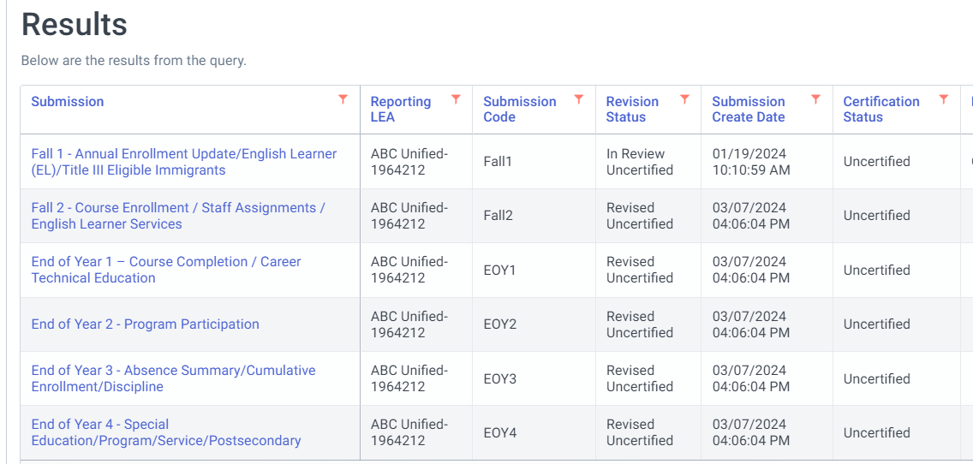
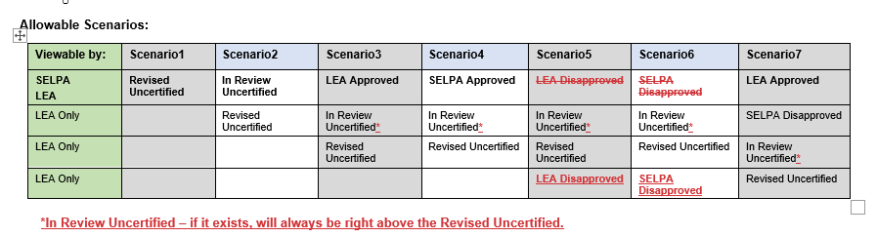
Change the Default Revision Shown When LEA/SELPA Disapproves
When a LEA or SELPA disapproves a revision, the default status will now show either In Review Uncertified (if it exists) or the most recent Revised Uncertified (that should always exist)
Notes:
Currently, when an LEA/SELPA disapproves the default status is “Disapprove” and not "Revised Uncertified." Often times the LEA/SELPA will reapprove prior revision that they just disapproved not realizing there is a newer revision (revised uncertified).

Slide 91
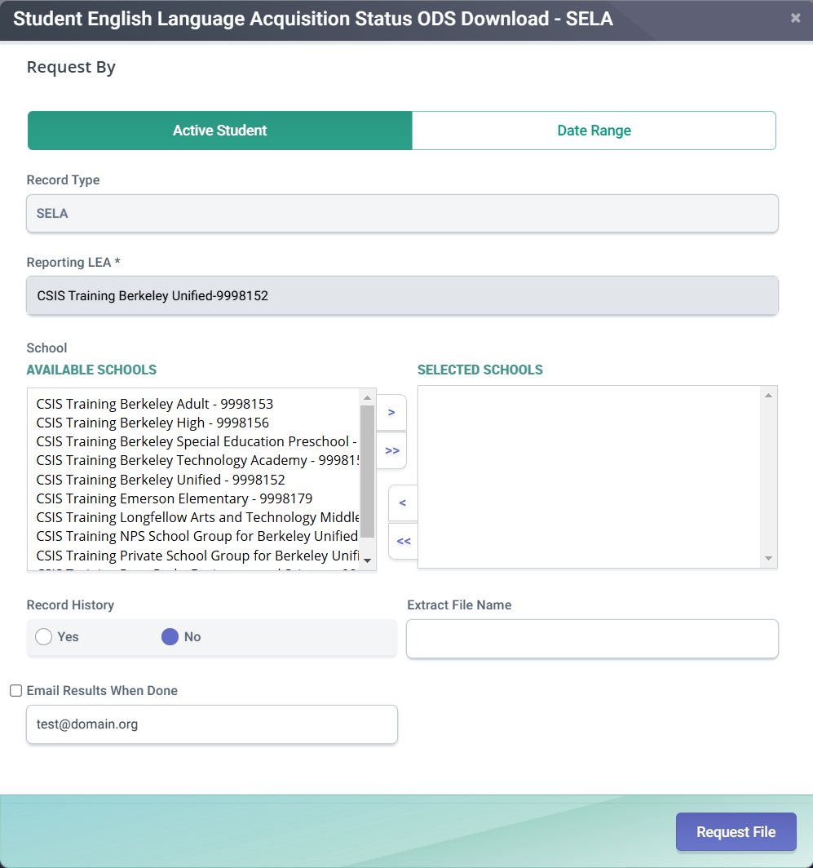
SELA ODS Extract
Filter Parameters modified to Extract Entire History and Most Recent ELAS & Email Notification feature
The most recent SELA status for a student, which makes it difficult for LEAs to look at ELAS history (usually needed for MID resolution). The only option currently is to use Online Maintenance and look at students one at a time.
User should be able to request & retrieve an extract based on:
  Actively enrolled SSIDs
  SSIDs enrollment starting within a date range
User should be able to select:
  Just the most recent SELA records per SSID based on ELAS Status Start Date (Default)
  All of the SELA records per SSID ELAs Status Start Date (History)
Email Notification:
Users can get notified once a requested extract is ready for download by checking the email notification box.
Notes:
The most recent SELA status for a student, which makes it difficult for LEAs to look at ELAS history (usually needed for MID resolution). The only option currently is to use Online Maintenance and look at students one at a time.

Slide 92
2024-25 – Cohort Report Change
Functionality | Change
Cohort - Reports | Modified - SN & CA Cohort Report 15.1 The rates and counts calculation for regular HS Diploma attributes has been modified to be based on Graduate Counts instead of Cohort Counts EOY Report Changes (SN, SELPA, C/A) Long-Term English Learner (LTEL) Reporting for EOY3 (Phase 1 for 24/25) Accountability reports modified by including the LTEL information to the cohort process and cohort reports level reports: 15.1 – Cohort – Counts and Rates - LTEL Filter Y/N option added 15.2 – Cohort Student List - LTEL Filter Y/N option and Long-Term English Learner column added

Slide 93

Certification Process Reminder
EOY 1 and 2 has ONE level of approval
LEA Approval
EOY 3 and 4 have TWO levels of approval
LEA Approval
SELPA Approval
Notes:
Some reminders…

Slide 94


Common Problems
Discuss EOY Common Problems
Notes:
Let’s review some of the common problem.

Slide 95
EOY Common Problems
SENR0649E3 - F
ELAS Student Not Reported - triggered for EOY-3
Solution
You must submit a SELA record for a student enrolled who has no SELA record.
Notes:
Replaces old CERT067 – F

Slide 96
EOY Common Problems - 1
STAS0708E3 - F
Missing Suspension Data for a student who was reported as absent due to either out-of-school suspension or in-school suspension
Solution
  Students who are reported as having in-school or out-of-school suspensions in the absence summary file must have associated Incident (SINC) data
Notes:
Replaced CERT156 - F

Slide 97
EOY Common Problems - 2
CERT097 – F
Missing Title I Targeted Assistance Program Records
Solution
Annual CARS update for Title 1 Schools (Targeted vs. Schoolwide) should be done early on
Notes:
Ensure your annual school designation in CARS is done early on to avoid CERT097 fatal certification error.

Slide 98
EOY Common Problems - 3
SENR0696E3 - F
Triggers when Student Enrollment Record in current active AY is not exited prior to EOY-3 certification.
Solution
All active academic year enrollments must be exited to clear this fatal error and to be able to certify EOY-3
Notes:
Replaced CERT131 – F - A student that was enrolled any time between July 1 and June 30 of the Active reporting Academic Year and has not been exited prior to August 16 of the next reporting Academic Year.

Slide 99

Wrap Up
Key Points, Resources and Support

Slide 100



Suggested Milestones
Now – 5/6
Complete Data Population in local SIS
Now – 6/19
Submit and post files. Review IVR and Data Discrepancy errors and reconcile as needed.
6/20 – 7/10
Resolve Certification and Data Discrepancy errors. Review snapshot reports and update records as needed
EOY
2024-2025
0
7/11
Recommended Date for Zero Errors
7/11– 7/18
Send reports to local data stewards, site leaders and administrators for approval (Send earlier if possible)
7/22 – 7/25
LEA Approve by Certification Deadline
(EOY 3 & 4 should be SELPA Approved if possible)
Amendment Deadline
(EOY 3 & 4 require SELPA Approval)
7/26 – 8/8

Slide 101

Strategies

Slide 102

EOY Considerations
Things to consider prior to submitting and certifying EOY:
Personal considerations
  Ease of submission, workload, summer break/vacation
Local factors
  Availability of school site staff and district personnel, internal deadlines
Priority of data submitted
  Perkins funding data, Public data statistics, Cohort results
Potential reporting milestones
  Last day of new enrollments, When are final grades available, last day of school
CALPADS deadlines
  Benefits and consequences of meeting the initial EOY deadline and amendment window deadline
Notes:
As part of improving your project management skills, here are some things to consider prior to submitting and certifying EOY…

Slide 103
EOY Planning
Identify Stakeholders, contributors, subject matter experts
  Brainstorm, list and the owners of EOY data and the stewards
Define stakeholder responsibilities and participation
  Use the EOY Checklist to outline submission and certification tasks for EOY stakeholders, site leaders
  Clearly define your role
Set expectations for submission and reporting
  Make a training calendar
  Create timeline for local milestones, use the EOY checklist
Create an understanding what success is
  Find a consensus on a reasonable certification date
  Explain the consequences of failing to review reports (dashboard, cohort)

Slide 104

Strategize
Submit data and certify individually depending on priority
  Which data collection is most important?
    EOY 3 Absence Summary/ Cumulative Enrollment/ Discipline (4yr cohort, suspension rate, chronic absenteeism, ESSA, UMIRS, IDEA, homeless)
    EOY 2 Program Participation (Title 1)
    EOY 4 (SWDS, PLAN, MEET, SERV, PSTS)
    EOY 1 Course Completion/ CTE (CTEIG Perkins data, College Career Indicators)
Submit data and certify concurrently
  When is the soonest data can be submitted based on availability? Is the data ready? Who needs to review the reports? Can the data be processed according to business rules and CALPADS input validations?
    Complete enrollment updates (SENR, SINF, SPRG and SELA records as part of ongoing maintenance will allow you to certify EOY 2)
    Submit course and staff data early in the submission window (SDEM & CRSC files can be submitted based on master schedules). Finish submission when final grades are released (Final grades may be available prior to last day of school)
    Submit and certify student discipline and absence summary after the last day of school (STAS and SDIS may have unexpected changes up until the last day of school)
    Have SPED person submit (SWDS, PLAN, MEET, SERV and PSTS) and certify
Notes:
EOY 3 has the bulk of the enrollment. In an effort to make sure all the enrollment records are accounted for, EOY 3 should be completed first. The recommended order of certification is: EOY 3, 2, 4, 1.

Slide 105
Strategize - 1
Submit data and certify by ease or proficiency
Which data collection are you most familiar with?
Who is available to review the reports?
How much time is required to complete the submission?
What is included in the submission?
  EOY 2 has the least number of changes and records may have already been submitted if ongoing maintenance is up to date, students participating at anytime during the year submitted
  EOY 3 may be most important and time consuming. SELPAs need to review discipline reports, all primary and short term enrolled student attendance reported and all enrolled students with disciplinary incident.
  EOY 1 is directly related to Perkins funding, data affects the CA school dashboard CCI, only data for 7-12 grades submitted
  EOY 4 reports on students with disabilities during the entire school year
Notes:
The strategy you implement should be made between now and the start of the official submission widow. Consult with the subject area experts, site staff and district admin to determine how best to complete the EOY submission.

Slide 106
Cohort Readiness & Considerations
Will you be the person handling the cohort processing? If yes:
  Have you reviewed the cohort training videos or are you planning to?
  Are you familiar with the new changes this year?
Have you downloaded the Cohort Checklist (in User Manual)?
Do you have a plan to work on Cohort parallel to EOY?
Do you need input/assistance from other staff from your LEA?
If so, are you aware of their summer schedule?
Are you aware that the cohort and EOY deadlines are the same?
Notes:
Change Cohort Process and reconcile earlier by end of July and work on remaining few at the end because Cohort ends one day prior to the deadline day. Check updated Checklist for information and tips.

Slide 107
Impact of not certifying
Annual Submission | State or Federal | State/Federal Data Usage | LEA Impact if Not Certified
EOY-1: Course completion Career Technical Education (CTE) participants and completers | State | DataQuest (Course Completion & CTE) | 0 counts
 |  | CTE Incentive Grant | 0 counts & grant eligibility
 |  | California School Dashboard (College/Career Indicator) | Potential Orange Indicator
 | Federal | Carl Perkins Program (CTE Participants and Completers) | 0 counts & grant eligibility
EOY-2: Program participation Homeless & TK enrolled counts | State | DataQuest (Programs such as Homeless and TK) | 0 counts
 | Federal | Elementary and Secondary Education Act (ESEA) Title 1, Part A Neglected | 0 counts & grant eligibility
 |  | EDEN (Education Data Exchange Network) Reporting | 0 counts
 |  | Consolidated State Performance Report (CSPR) | 0 counts
EOY-3: Absence Summary/Cumulative Enrollment/Behavioral Incident | State | DataQuest (Discipline, Chronic Absenteeism, Cumulative Enrollment) | 0 counts
 |  | California School Dashboard (Suspension & Chronic Absenteeism indicators) | Potential Red Indicator
 | Federal | NCLB Consolidated State Performance Report (CSPR) | 0 counts
 |  | NCLB Title IX - At Risk/Persistently Dangerous Schools | 0 counts
 |  | ESEA Title IV, Part A, Subpart 3, Section 4141 (e) - Firearm Offenses | 0 counts
 |  | Individuals with Disabilities Education Act (IDEA) | 0 counts
 |  | Gun Free Schools Act Annual Survey | 0 counts
Notes:
This slide shows what data is submitted for EOY and what it is used for both at the state and federal levels. It also shows what impact it will have if your LEA does not certify EOY.
Reminder – Please note that your EOY 1 and 3 data submission is the data source for some of the indicators of the Ca. School Dashboard. Therefore, it is becoming even more critical to complete and certify the EOY submissions on time.

Slide 108

Summary
The data in EOY is reflective of entire academic year.
Review EOY changes internally with other staff as needed.
It will greatly benefit you to clear all Certification and CDDs by July 11th to ensure reports are checked for accuracy before they are approved.
Use the EOY Checklist to plan for and meet the submission milestones and deadline.
LEAs should plan to certify all EOY submissions by the submission window deadline.
Amendment window should only be used for minor updates and corrections to data.
There will be no deadline extension!
Attend the CALPADS Q&A when feasible
Communicate, Collaborate and Coordinate!!
Some key points to remember

Slide 109




Resources
Here are some important resources related to EOY reporting.
  https://learn.fcmat.org/
https://www.youtube.com/c/CSISCALPADSTrainingChannel
https://documentation.calpads.org/Support/References
https://www.cde.ca.gov/ds/sp/cl/systemdocs.asp
https://csis.fcmat.org/resources

Slide 110





Support
http://www2.cde.ca.gov/calpadshelp/default.aspx
Web
calpads-support@cde.ca.gov
Email
916-325-9210
Phone
https://csis.fcmat.org/ListServ
https://www.cde.ca.gov/ds/sp/cl/listservs.asp
You can get help through these channels.
Listserv

Slide 111
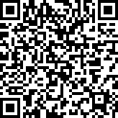
Feedback
Please complete survey…
https://bit.ly/2MXsECg
“
”
Notes:
Please take the time to complete our training survey. Your responses assist in improving our trainings.
We review these surveys on a regular basis—in fact due to LEAs’ suggestions we have changed our survey, have included more visual aids, and demonstrations in our trainings.
If you experience any technical difficulty with accessing the survey, please try the alternative long URL:
Long URL: https://forms.office.com/Pages/ResponsePage.aspx?id=k1b3XxqV6E2E3dWxsESwNX2FYi3dRZNNt8LpvkF_wmhUNVRLOVBDVkoySE01UTJSRk42VTlaUUFIQi4u
Short URL: https://bit.ly/2MXsECg
Thank you for providing us the opportunity to evaluate our trainings.

Slide 112






Thank You
CSIS Training
+1 916 325 9210
csistraining@fcmat.org
https://csis.fcmat.org/

Slide 113


